Slide 1
EMPLOYEE SALARY PREDICTION MODEL
CAPSTONE PROJECT
Presented By:
Ritoban Datta-
SRM University of science and technology ,
Ramapuram,Chennai

Slide 2
OUTLINE
Problem Statement
System Development Approach
Algorithm & Deployment
Result
Conclusion
Future Scope(Optonal)
References

Slide 3
Problem Statement
In today’s data-driven world, organizations handle large amounts of employee information related to demographics, job roles, education, and work patterns. Understanding and predicting an employee’s income class based on these attributes can aid in better workforce planning, talent acquisition, and compensation structuring. However, manually analyzing such data is time-consuming and prone to bias or inaccuracy. There is a need for an intelligent system that can automate this process and deliver consistent predictions. The goal is to create a transparent and data-driven model for salary estimation.

Slide 4
System Approach
Language: Python
Libraries:
pandas,
numpy,
scikit-learn,
matplotlib,
seaborn,
joblib
IDE: Jupyter Notebook
Frontend: Streamlit
Deployment: Local/Cloud using Streamlit or Flask
Model: Linear Regression and SVM tested, SVM selected

Slide 5
Algorithm & Deployment
Data Collection: Dataset with employee details (Years, Job Rate, Sick Leave, Unpaid Leave, Department).
Preprocessing:
Handle missing values
Convert categorical features (Department) using Label Encoding
Outlier detection and removal
Model Training:
Compared Linear Regression, Decision Tree, and SVM
Used GridSearchCV for optimization
Model Evaluation:
Chose the best model (SVM) based on R² score
Saved model using joblib
Frontend Development:
Streamlit used to build a user-friendly form
Model loads and predicts salary in real-time

Slide 6
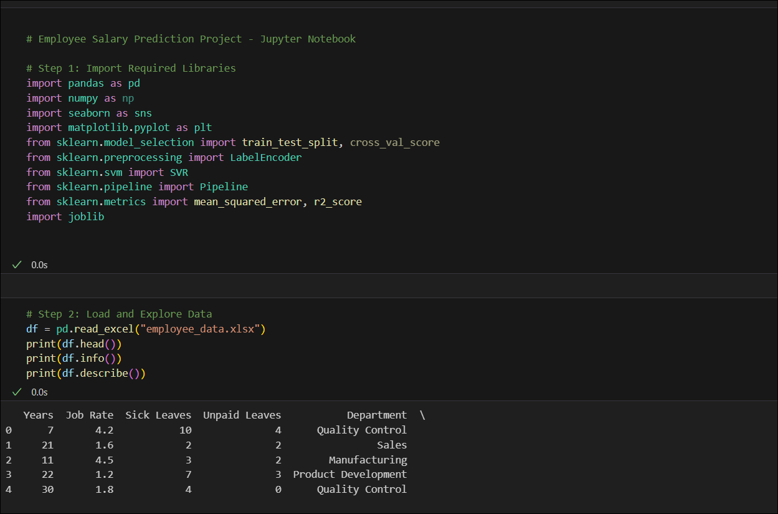
Result

Slide 7
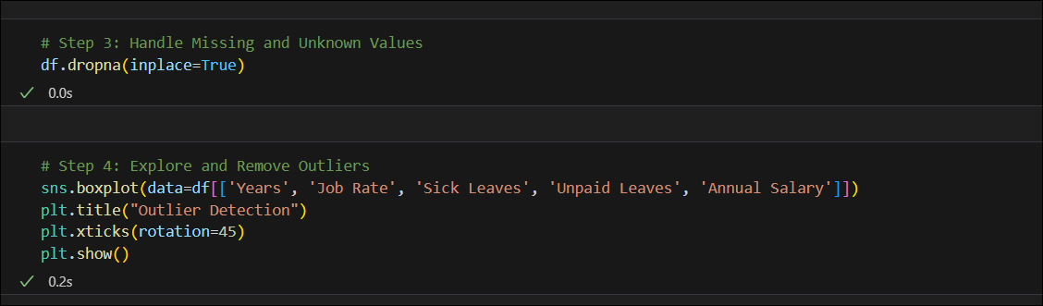
Result

Slide 8
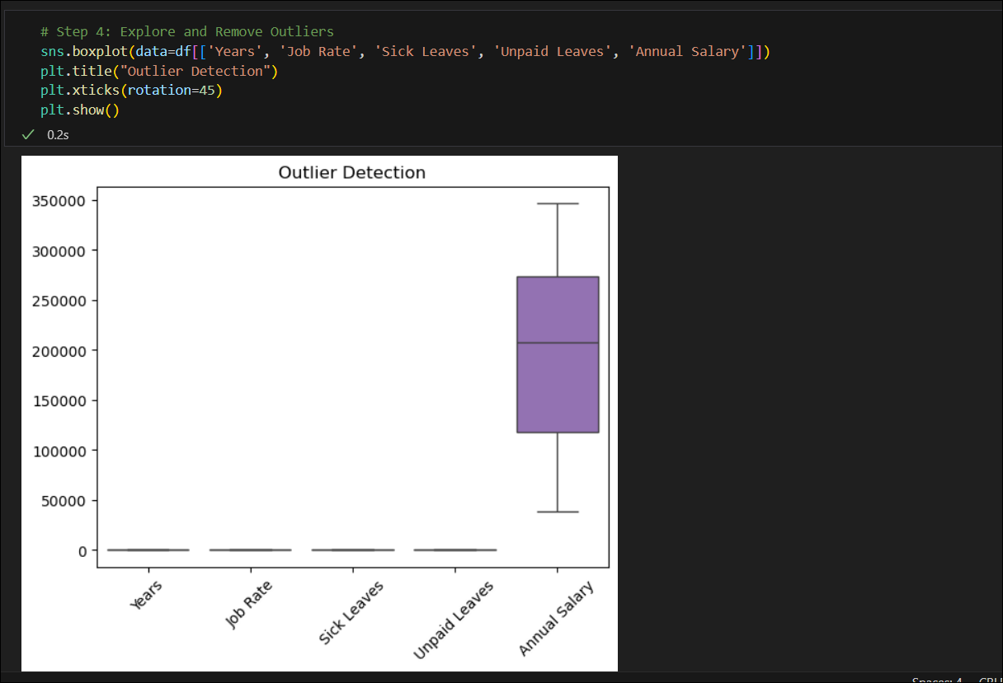
Result

Slide 9
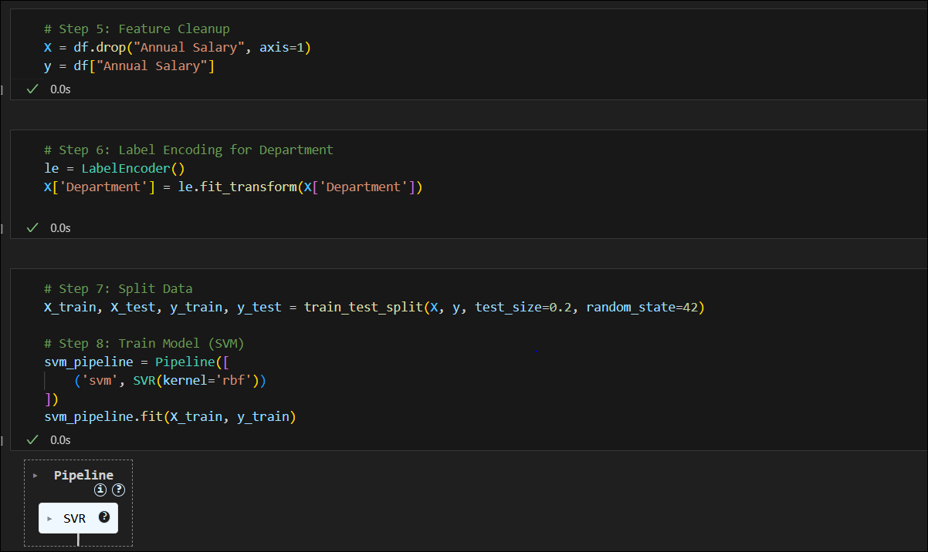
Result

Slide 10
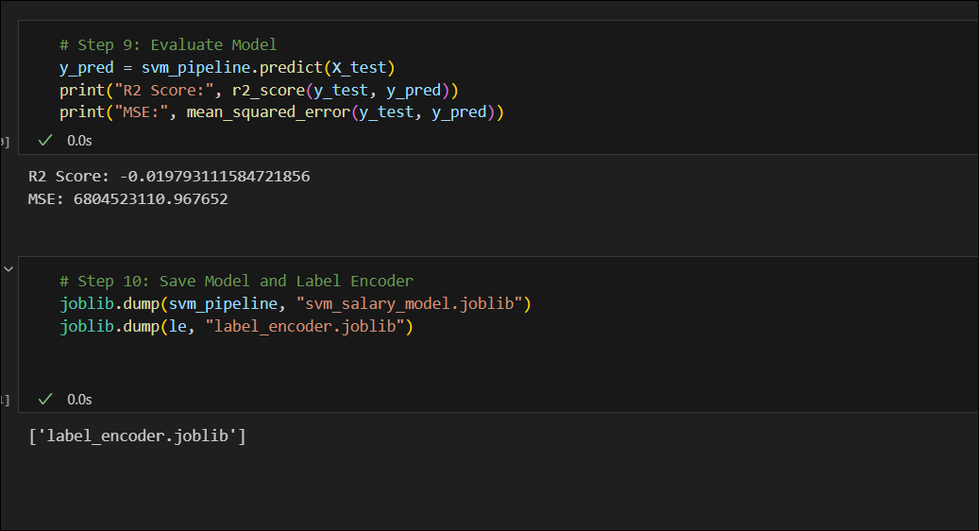
Result

Slide 11
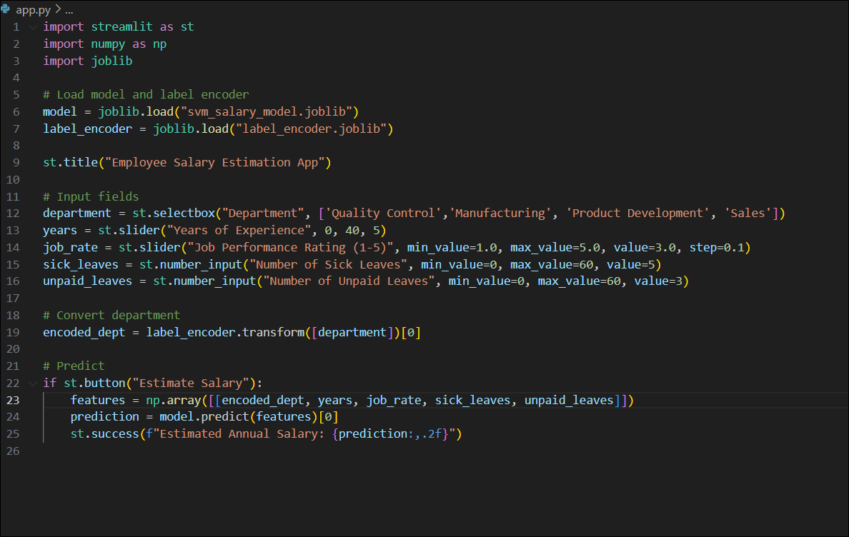
Result

Slide 12
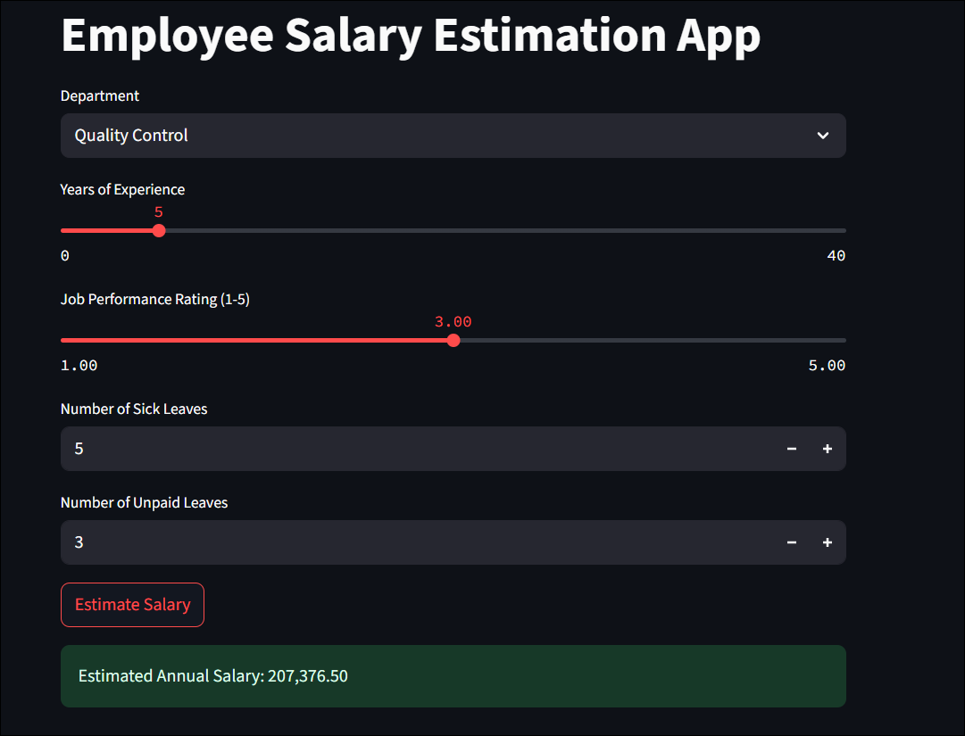
Result - Output

Slide 13
Result - Output
Attach your Github link
https://github.com/ribobun/Employee-Salary-prediction-model.git

Slide 14
Conclusion
The project successfully developed a machine learning-based employee salary prediction system using a dataset with features such as department, experience, job rate, leaves, and overtime hours. After experimenting with multiple models, the Support Vector Machine (SVM) algorithm provided the highest accuracy, indicating strong generalization capabilities for regression on this dataset.
Challenges encountered included:
Handling missing or unknown values without distorting data distribution.
No real difference in salary irrespective of difference in inputs.
Encoding categorical features while maintaining interpretability.
Balancing model complexity vs interpretability for non-technical users.
Potential improvements:
Integrate a larger real-world dataset for better generalization.
Add explainability (e.g., SHAP values) to interpret salary drivers.
Overall, the solution met the objectives and provides a strong base for expansion into HR analytics tools.

Slide 15
Future scope
Add more features like:
Educational Qualification
Past Promotion History
Certification or Training Count
Integrate with company HR systems for real-time deployment
Extend to other domains (e.g., freelance pricing)

Slide 16
References
Dua, D. and Graff, C. (2019). UCI Machine Learning Repository: Adult Income Dataset. Irvine, CA: University of California, School of Information and Computer Science.https://archive.ics.uci.edu/ml/datasets/adult
Scikit-learn: Machine Learning in Python. Pedregosa et al., Journal of Machine Learning Research, 2011.https://scikit-learn.org
Streamlit Documentation – The fastest way to build and share data apps.https://docs.streamlit.io
Python Data Science Handbook by Jake VanderPlas – O’Reilly Media, 2016.
Géron, A. (2019). Hands-On Machine Learning with Scikit-Learn, Keras, and TensorFlow. 2nd Edition. O’Reilly Media.

Slide 17
THANK YOU

